Slide 1
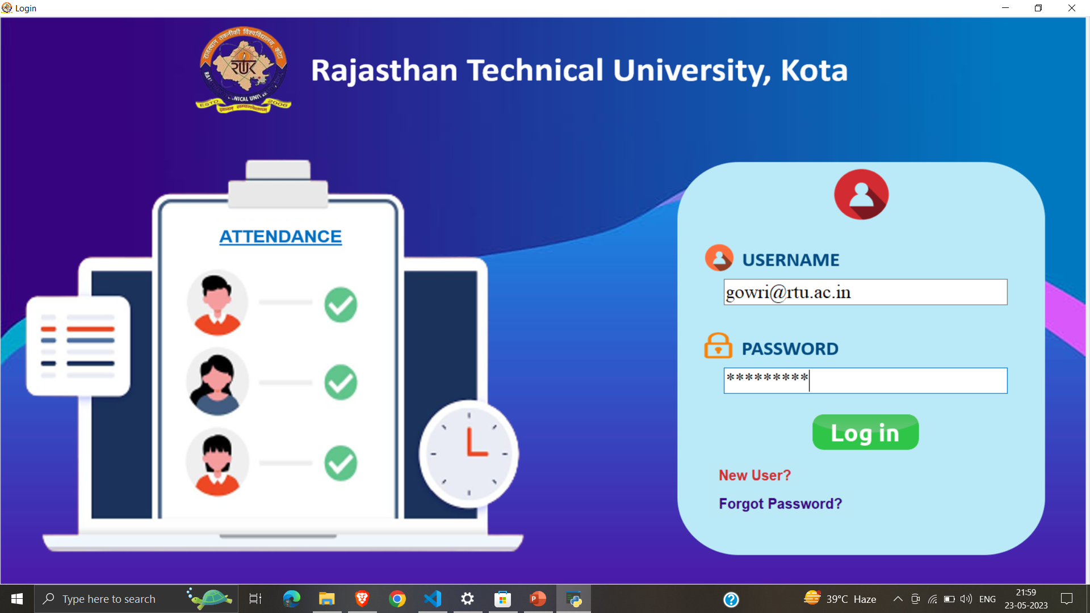
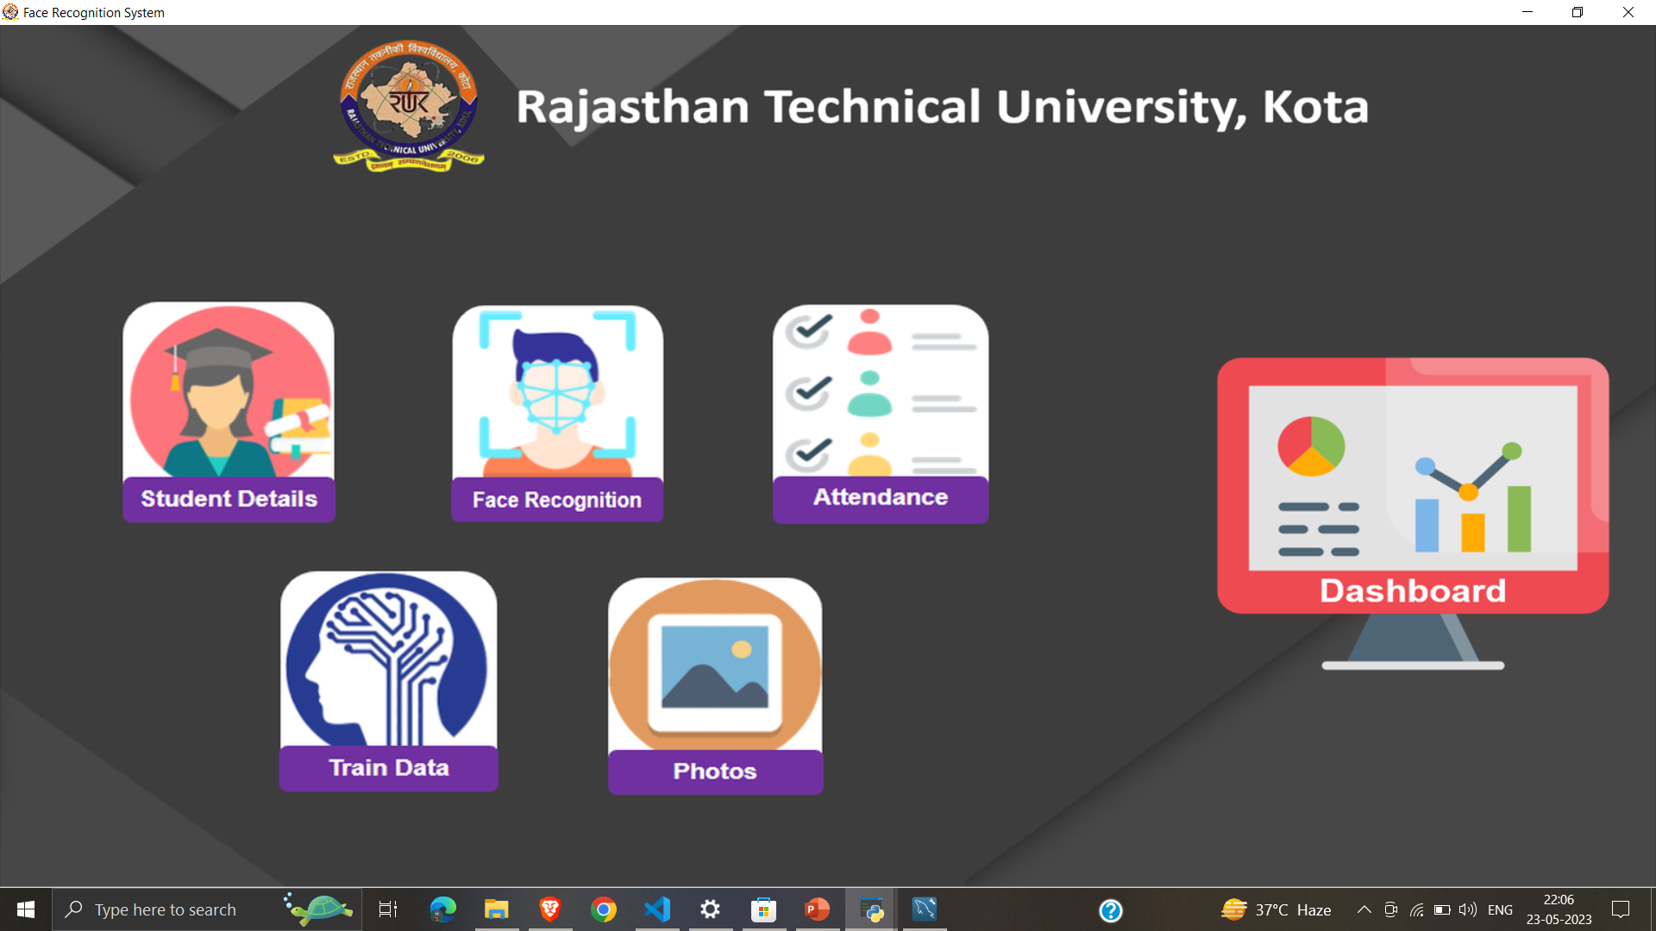
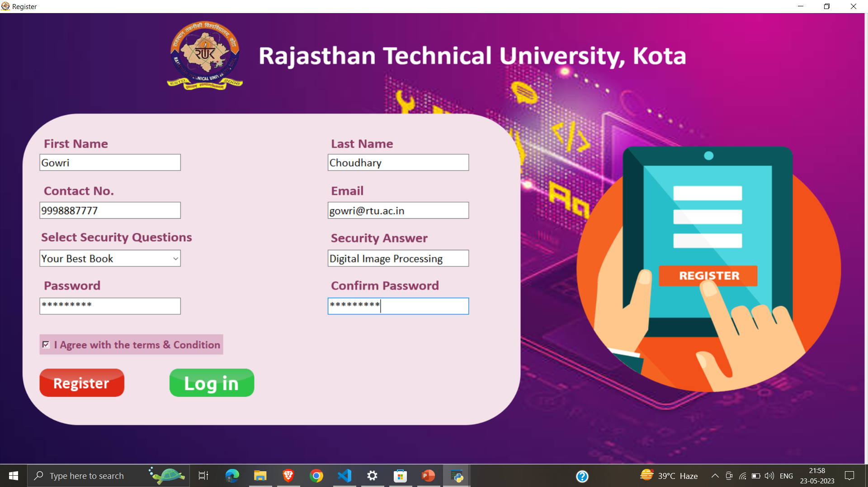
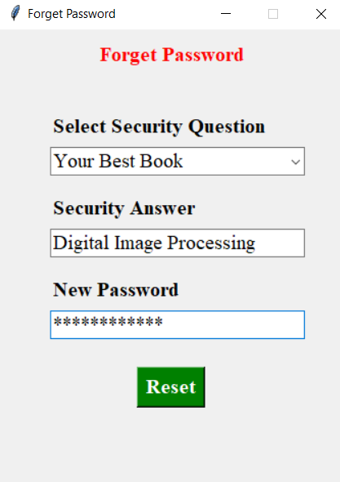
Project Snapshot

Slide 2
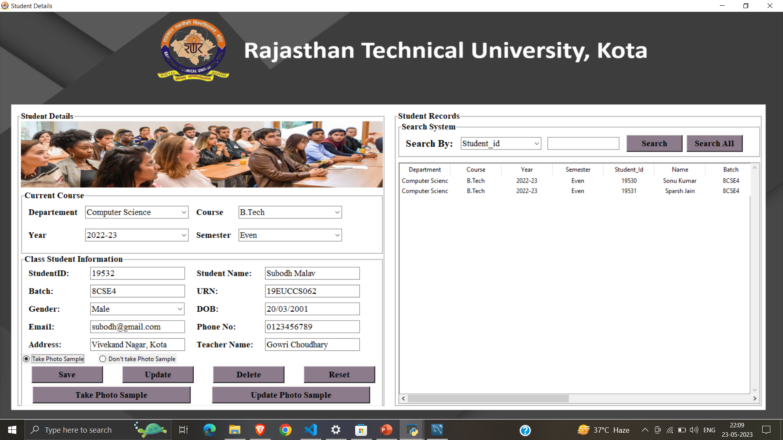

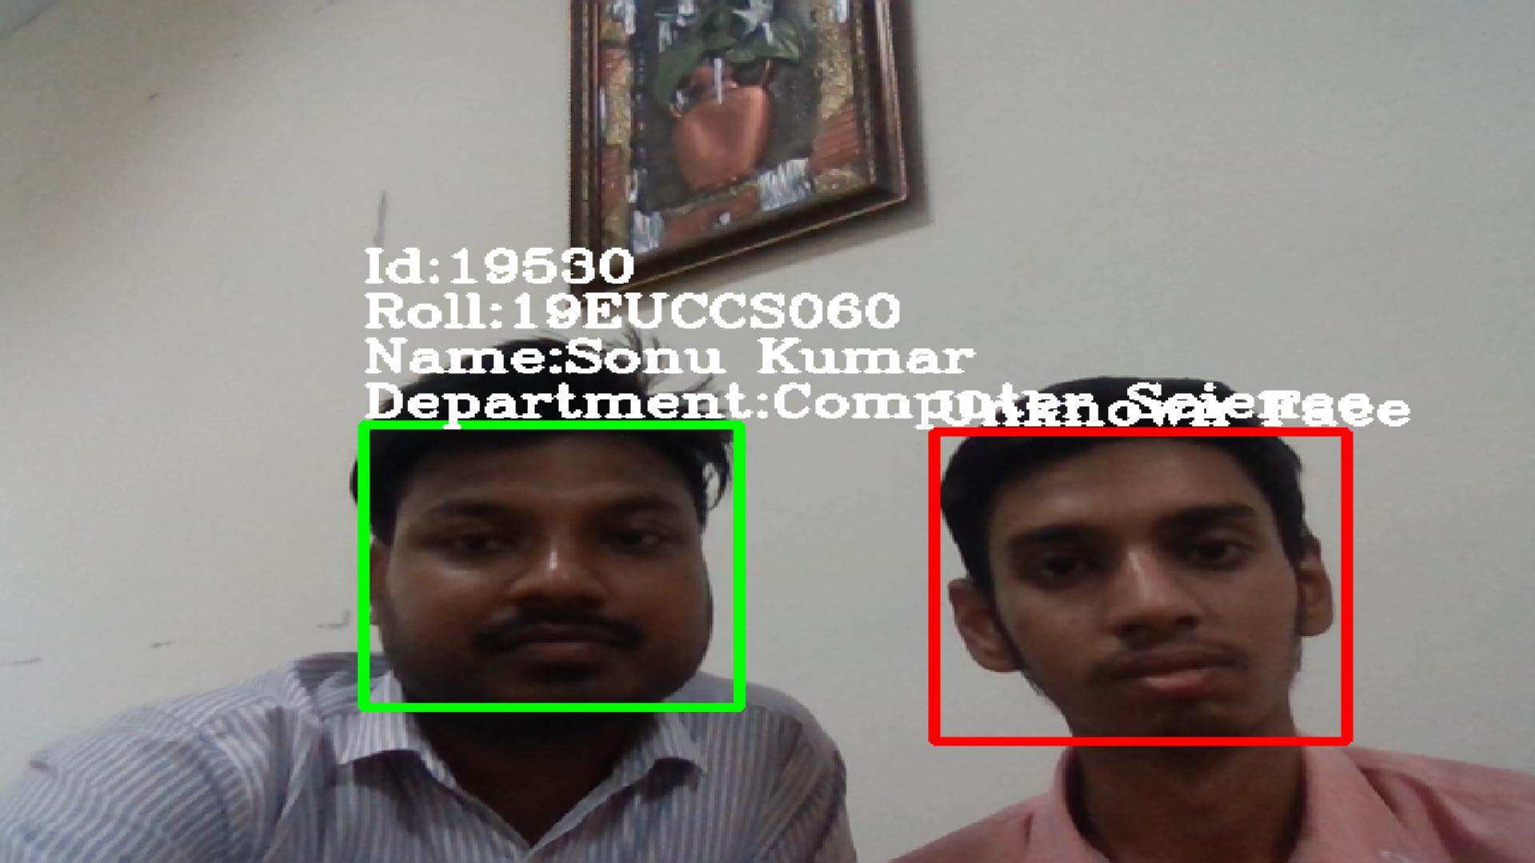
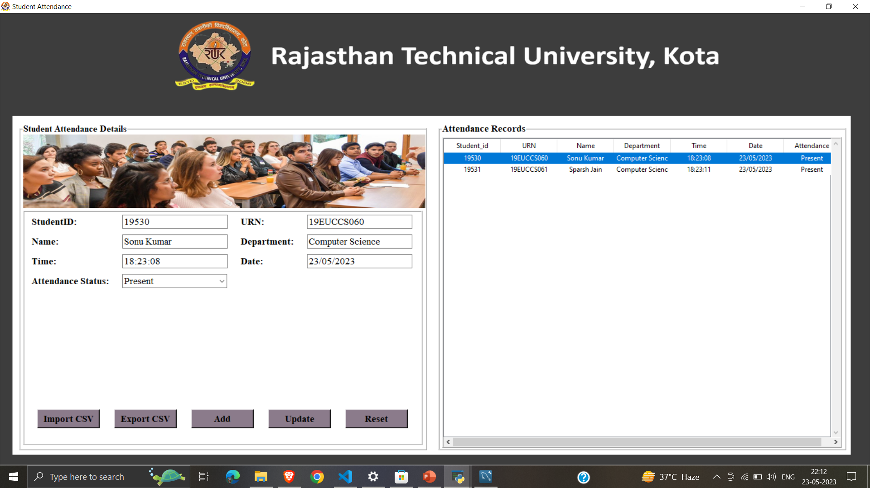
Project Snapshot (cont…)

Slide 3
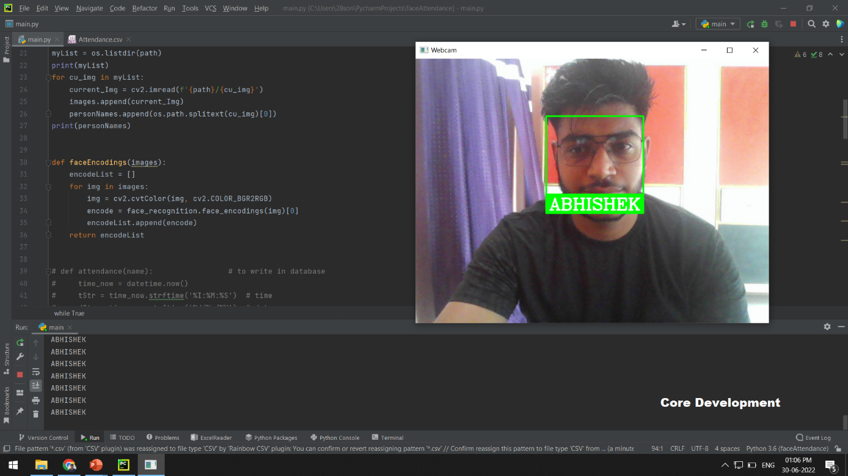


Slide 4





Rajasthan Technical University, Kota
ATTENDANCE
USERNAME
PASSWORD
Login
New User?
Forget Password?

Slide 5


Rajasthan Technical University, Kota
First Name
Last Name
Contact No.
Email
Select Security Questions
Security Answer
Select
>
Password
Confirm Password
I Agree the Terms & Conditions
Register
Login

Slide 6







Rajasthan Technical University, Kota
Student Details
Face Recognition
Attendance
Dashboard
Train Data
Photos

Slide 7
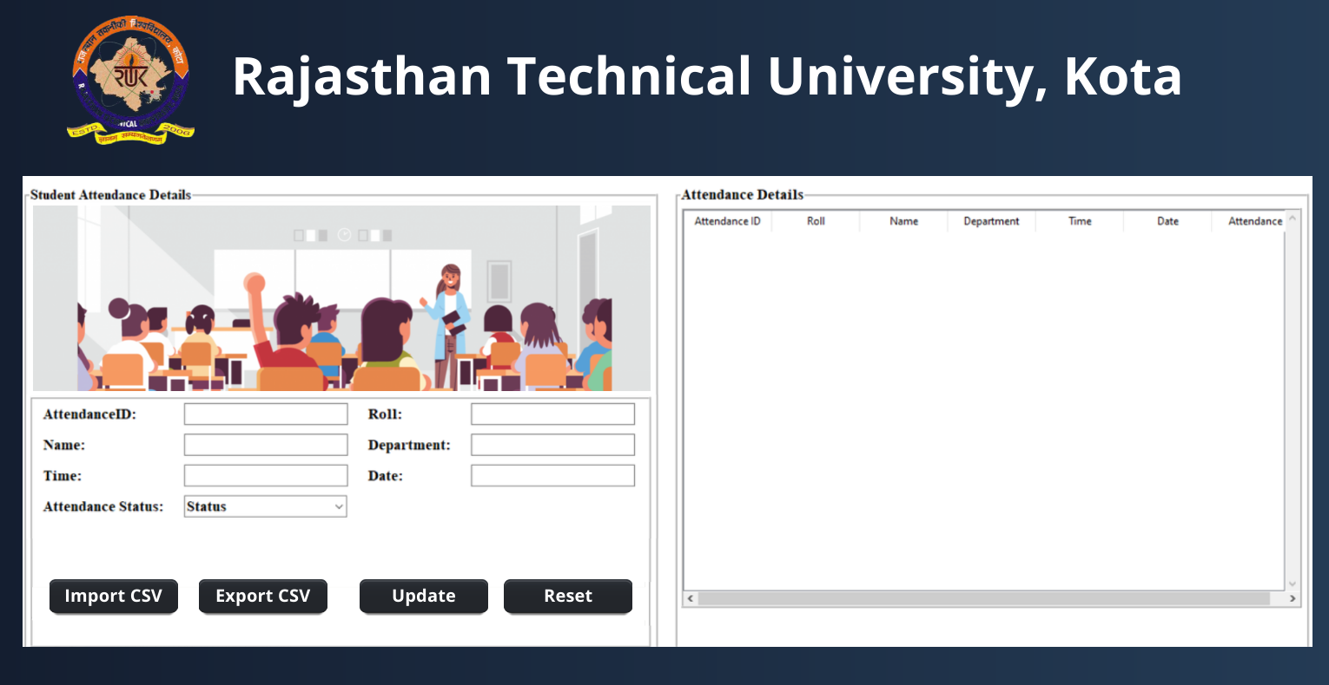

Slide 8
